Slide 1
DDoS Attack Detection Using ML

Slide 2
Problem
DDoS attacks involve overwhelming a target system with traffic from multiple compromised sources, leading to service disruption.
These attacks are increasingly complex and voluminous, outpacing traditional cybersecurity measures.
They cause significant service disruptions, financial losses, and reputational damage to organizations.

Slide 3
Why ML Solution?
Machine Learning enhances DDoS attack detection by analyzing network traffic in real-time to identify unusual patterns.
ML-based solutions are proactive, adapting to new and evolving attack methods, unlike traditional, rule-based systems.
Implementing ML in cybersecurity ensures better network resilience, business continuity, and data protection against these sophisticated attacks.

Slide 4
Models
Decision Trees and Random Forests:
They can be trained to recognize patterns of normal network traffic and identify deviations indicative of an attack.
Neural Networks, Including Deep Learning:
Deep learning models like CNNs and RNNs, are adept at processing large and complex datasets. They can learn to detect subtle and complex patterns in network traffic, making them suitable for identifying sophisticated DDoS attacks that might not trigger traditional detection systems.
Support Vector Machines (SVM):
SVMs can effectively differentiate between normal traffic and attack traffic, even in high-dimensional spaces, making them useful for detecting intricate attack patterns.

Slide 5
NSL-KDD Dataset
NSL-KDD contains a set of network interactions that are labeled as either normal or as an attack, with one of several different types of attacks.
The attacks fall into four main categories: Denial of Service (DoS), Probe, User to Root (U2R), and Remote to Local (R2L).
Usage: It's commonly used in the cybersecurity field for researching and developing machine learning models that can identify and classify network intrusions. The dataset is particularly useful for training and testing anomaly detection systems.
NSL-KDD is available on platforms like Kaggle, making it easily accessible for researchers and practitioners in the field of cybersecurity.

Slide 6
Data Preprocessing and Feature Engineering
Mapping ordinal attack labels into numeric valued labels for better prediction model
Encode non numeric valued columns
Append missing features in test set w.r.t training set with 0 ‘s
Reorder test set and training set w.r.t columns
Train data: 60%
Test data: 40%

Slide 7
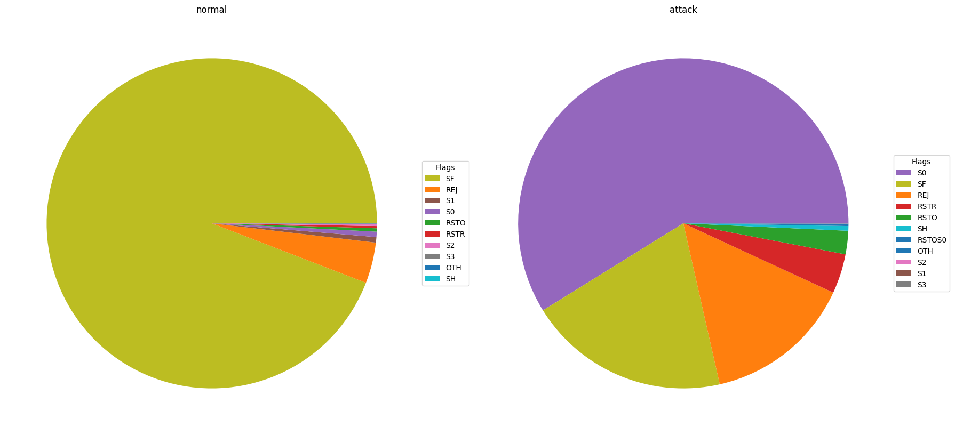
Data Visualisation

Slide 8
Training, Evaluation and Prediction
Model for training: Random Forest Classifier
Models for comparison(metric cross-validation score):
Logistic Regression
KNeighbors Classifier
Prediction:
Summarizing performance of Random Forest Classifier with prediction on test data with confusion matrix

Slide 9
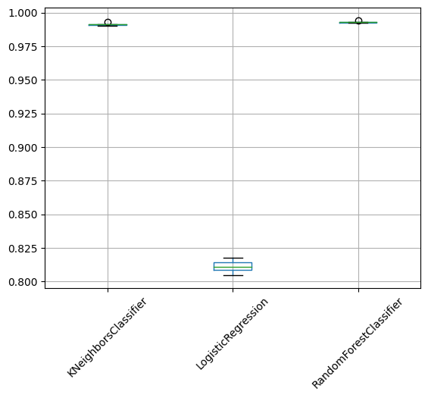
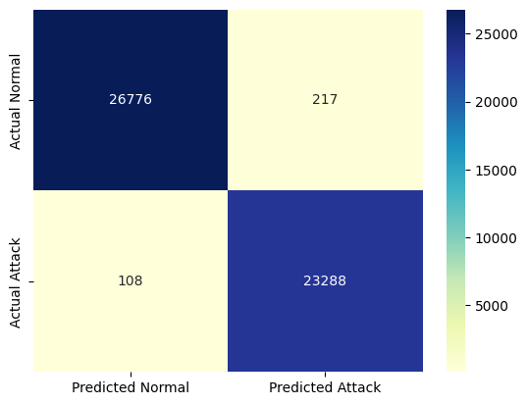
Results
cross_val_score
Confusion matrix

Slide 10
Thank You

